Slide 1

PRESENTED BY:-
Aarzu Awal
Muskan Thapa
Manasha Laxmi Gurung
Niru Shrestha
Bishwash Dangol

Slide 2
CONTENTS
Introduction
Vision, Mission and Goals
Operations Management in Coca Cola
Coca Cola Manufacturing
Total Quality Management (TQM)
Inventory Management
Conclusion

Slide 3
COMPANY DESCRIPTION
Head quartered in Atlanta, Georgia
Beverage retailer, manufacturer and marketer
Offers 500+ brands and has 3500+ beverages
200+ countries
125 years in business
139,600 world wide employees
49 consecutive years with increased revenue

Slide 4
MISSION
“At the coca cola company we strive to refresh the world, inspire moments of optimism and happiness, create value and make a difference”

Slide 5
VISION
People,
Portfolio,
Partners,
Planet,
Profit,
Productivity

Slide 6
GOALS
To deliver a wide range of beverages that meet different consumer preferences and needs.
To provide quality products that consistently meet the highest standards of taste and safety.
To create sustainable value for consumer, communitites and stakeholders.
To be an inclusive and diverse company that fosters an inclusive work environment.
To promote environmental sustainability and minimize the company’s environmental impact.

Slide 7
COMPANY HISTORY
Dr. john smith created the company in may 8, 1886
Asa Griggs Candler was given the rights to coca cola for $2300
Began expanding in 1923
Roberto Guizetto became CEO in 1981 and used “intelligent risk taking to expand”
Entered new markets and brands in 1990 for further growth
Universal product

Slide 8
MAJOR CHALLENGES
Health issues
Environmental effects
Business ethics
Cola war

Slide 9
INTERNATIONAL OPERATIONS
Sustainability
Agricultural advocacy
Sponsorship
World wide learning

Slide 10
MARKETING VIA GLOBAL PARTNERSHIPS
Mobile marketing
Olympic games
FIFA world cup
Music artist
Community outreach
Happy truck
Expedition 206

Slide 11
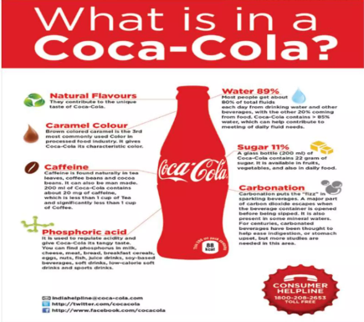

Slide 12
GLOBAL BRAND
Carbonated (Sparkly) Drink Producer
Sports Drink Producer
Bottled Water Producer
Started globalizing in the 1890s, first branching out to Cuba and Canada
Overseas Sales = 2/3 of Coca Cola’s revenue, ¾ of operating income
Manufacturing and Bottling
20 plants overseas manufacture beverages
300 bottling subsidiaries

Slide 13
SWOT ANALYSIS
Strength
Leading market presence, Built on strong brand portfolio
Weakness
Product recall tarnishing brand image
Opportunity
Shift focus from volume to volume, price, mix
Threat
Evolving consumer preferences

Slide 14
MANUFACTURING
Primary inputs : chemicals, vanilla beans, kola nuts, sweeteners, cans, supplies
Outputs : Satisfied customers and soft drink products
Packaging : taken to the packaging centres in cans. Special protection to prevent mixing with another chemicals.
The expected quantity of the carbon dioxide used

Slide 15
TOTAL QUALITY MANAGEMENT (TQM)
Highest standards and processes for ensuring consistent product safety by coca cola management system (TCCMS)
The quality index rating of coca cola company was 94.5
Try to identify the problems and refer or address the problems to the top executives of the organization

Slide 16
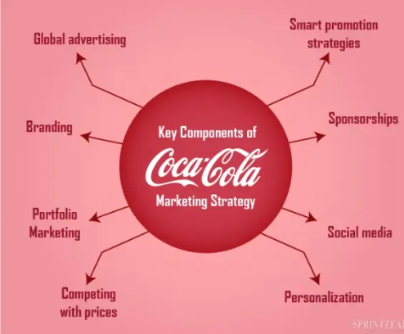
MARKETING STRATEGY

Slide 17
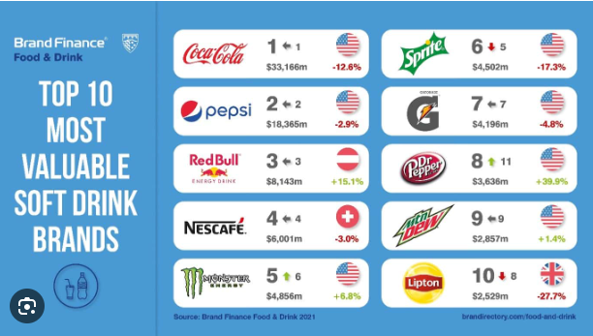

Slide 18
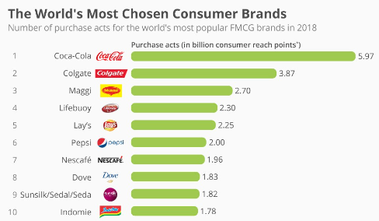

Slide 19
INVENTORY MANAGEMENT
Use a system, Track it. Track it is specialized software that pulls the information from Coke’s mainframe database and transfers it to handheld terminals with built-in laser scanners.
When each vending machine bar code is scanned, that number will be compared to each number Track It and the database is automatically updated.

Slide 20
FOREIGN DIRECT INVESTMENT
Mainly enters into partner ship overseas instead of green field to protect its licensing and its secret formula
In 2006 coca cola owned bottling subsidiaries brought together under the bottling investment operating group
Most bottling subsidiaries locally owned

Slide 21
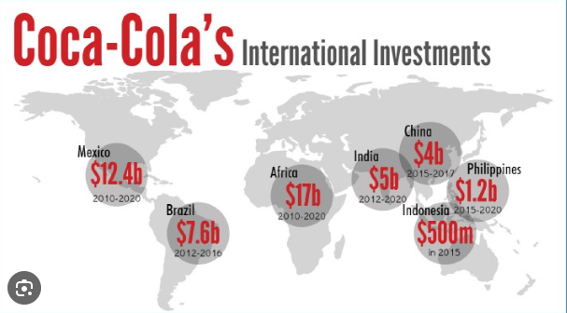

Slide 22
RECOMMENDATIONS
Assume control of more bottling subsidiaries
Invest more in Research and Development
Develop more health conscious product
Adopt more locally responsive flavor of drinks

Slide 23
CONCLUSION
Bottling subsidiaries :-
Form committees to create proposals for subsidiaries
Create standard ethics, codes
Create incentives
Health drinks and new flavors :-
Invest in Research and Development
Coca cola “ambassadors” to gaze response

Slide 24
THANK YOU!!!

